Slide 1
Python was created by Guido van Rossum during 1985- 1990.(Released 1991)
Python is a high-level, interpreted, interactive and object-oriented scripting language. Python is designed to be highly readable. It uses English keywords frequently where as other languages use punctuation, and it has fewer syntactical constructions than other languages.

Slide 2
Features of python-
Simple
Easy to learn
Open source
High level language
Platform independent
Portable
Procedure and object oriented
Interpreted
Embeddable

Slide 3
Huge library
Scripting Language
Database connectivity
Scalable

Slide 4
Understanding the Execution of Python Program
a = 10
b = 10
print("Sum ", (a+b))
Output:
Sum=20

Slide 5
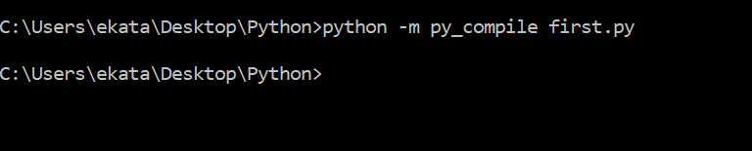
Suppose the above python program is saved as first.py. Here first is the name and .py is the extension. The execution of the Python program involves 2 Steps:
Compilation
Interpreter
Compilation
The program is converted into byte code. Byte code is a fixed set of instructions that represent arithmetic, comparison, memory operations, etc. It can run on any operating system and hardware. The byte code instructions are created in the .pyc file.

Slide 6
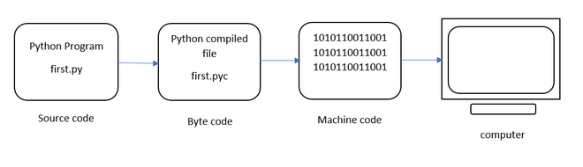
Interpreter
The next step involves converting the byte code (.pyc file) into machine code. This step is necessary as the computer can understand only machine code (binary code). Python Virtual Machine (PVM) first understands the operating system and processor in the computer and then converts it into machine code. Further, these machine code instructions are executed by processor and the results are displayed.

Slide 7
However, the interpreter inside the PVM translates the program line by line thereby consuming a lot of time. To overcome this, a compiler known as Just In Time (JIT) is added to PVM. JIT compiler improves the execution speed of the Python program. This compiler is not used in all Python environments like CPython which is standard Python software.
To execute the first.cpython-38.pyc we can use the following command:

Slide 8
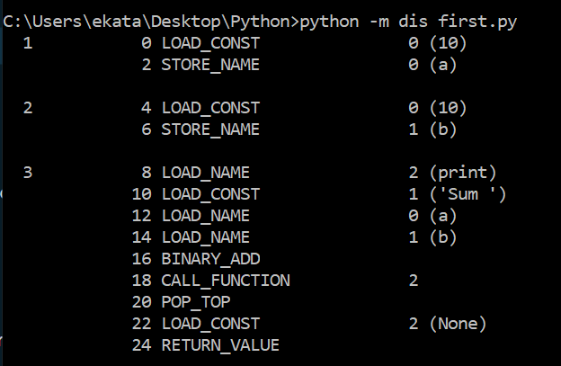
To view the byte code of the file – first.py we can type the following command as :

Slide 9
The dis command is known as “disassembler” that displays the byte code in an understandable format. The code represents 5 columns:
Line Number
offset position of byte code
name of byte code instruction
instruction’s argument
constants or names (in brackets)

Slide 10
Flavors of python-
Types of Python compilers are referred as flavors of Python. They help to integrate various types of programming languages in Python some of them are:
1. CPython:
It is a Python compiler that was implemented in C language. Even C++ code can be execute using CPython.
2. JPython:
It is enables Python implementation to be run on Java platform. It runs on JVM.
3. IronPython:
It is compiler designed for .NET framework, but it is written in C#. It can run on CLR(Common Language Run time).
4. PyPy:
It is a Python implemented by using Python language itself. It runs fast since JIT is incorporated to PVM.

Slide 11
5. Ruby Python:
It acts as a bridge from Ruby to Python interpreter. It embeds the Python interpreter inside the Ruby application
6. Pythonxy:
It is written in the form of Python(X,Y). It is designed by adding scientific and engineering related packages.
7.Anaconda Python:
The name Anaconda Python is obtained after redeveloping it to handle large scale data processing, predictive analytics and scientific computing. It handles huge amount of data.
8. Stackless Python:
Tasklets are the small tasks that are run independently. The communication is done with each by using channels. They schedule, control and suspend the tasklets. Hundreds of tasklets can run by a thread. The thread and tasklets can be created in stackless python. It is a re-implementation of python.

Slide 12
Data Types-
None
Numeric
Int
Float
Complex
Binary, Octal and Hexadecimal
Sequences
str, bytes, bytearray, list, tuple, range
Sets
Set, frozenset
Mappings
6) Boolean

Slide 13
1) None
The None keyword is used to define a null value, or no value at all.
None is not the same as 0, False, or an empty string.
None is a data type of its own (NoneType).
x = None if x: print("Do you think None is True") else: print("None is not True...")

Slide 14
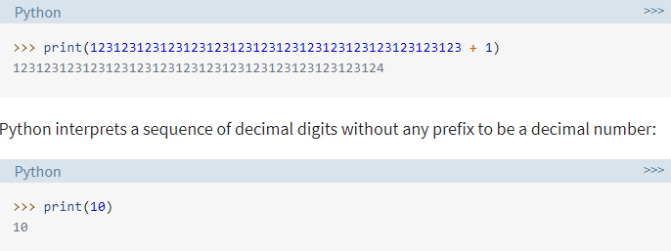
2) Numeric a) Integers
In Python 3, there is effectively no limit to how long an integer value can be. Of course, it is constrained by the amount of memory your system has, as are all things, but beyond that an integer can be as long as you need it to be:

Slide 15
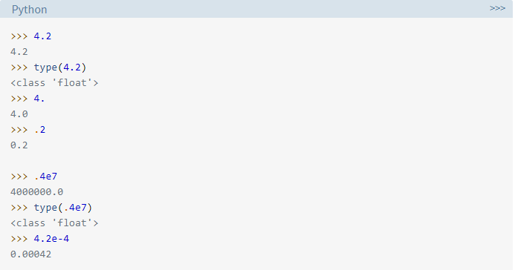
b) Floating point number
The float type in Python designates a floating-point number. float values are specified with a decimal point. Optionally, the character e or E followed by a positive or negative integer may be appended to specify scientific notation.

Slide 16
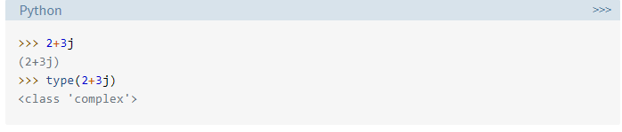
c) Complex Numbers
Complex numbers are specified as <real part>+<imaginary part>j.
j indicates square root of -1.
Real and imaginary part may contain integers or floats.

Slide 17
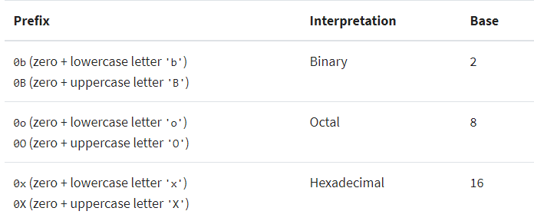
d) Binary, Octal and Hexadecimal
The following strings can be prepended to an integer value to indicate a base other than 10:

Slide 18
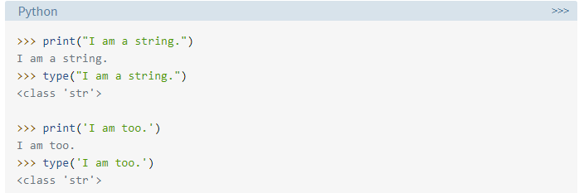
3) Sequences a) String
Strings are sequences of character data. The string type in Python is called str.
String literals may be delimited using either single or double quotes. All the characters between the opening delimiter and matching closing delimiter are part of the string:

Slide 19
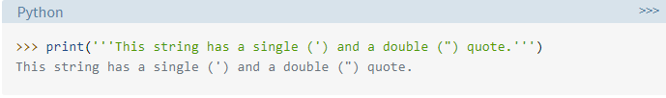
Triple-Quoted Strings
There is yet another way of delimiting strings in Python. Triple-quoted strings are delimited by matching groups of three single quotes or three double quotes. Escape sequences still work in triple-quoted strings, but single quotes, double quotes, and newlines can be included without escaping them. This provides a convenient way to create a string with both single and double quotes in it:

Slide 20
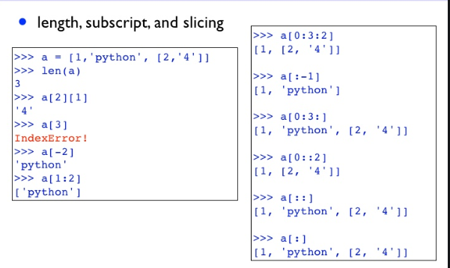
b) list
Similar to arrays in C or Java. It contains group of elements.
Main difference in list and array is that list can store elements of different types.
List can grow dynamically. Represented using square brackets [ ].
Lst=[10,-20,15.5,’Vijay’,”Merry”]

Slide 21
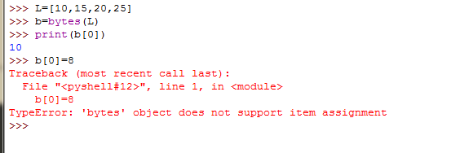
c) bytes
Group of byte numbers just like an array
It is any positive integer between 0 to 255
Cannot store negative number.
for I in x: print(i)

Slide 22
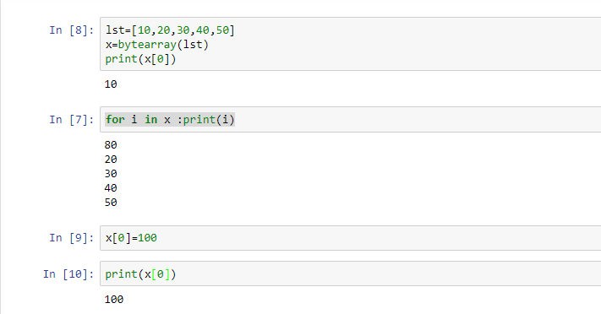
d) bytearray
Bytes type array cannot be modified but bytearray type can be modified.
Any element or all elements can be modified.

Slide 23
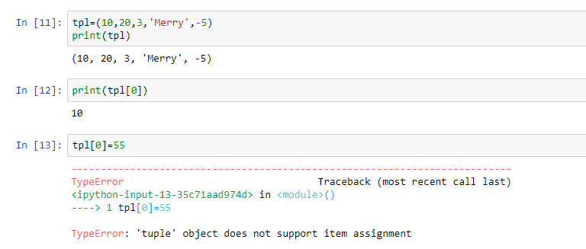
e) tuple
Similar to list, enclosed by parenthesis ( ).
Main difference is that list can be modified but tuple element we cannot modify.

Slide 24
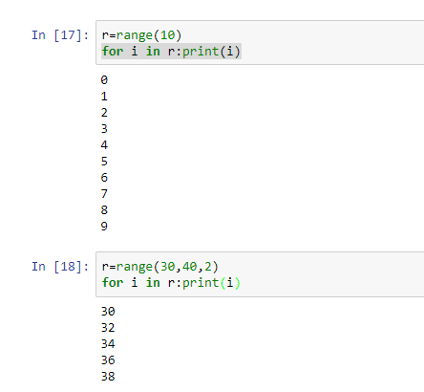
f) range
It represents sequence of numbers.
Numbers in a range are not modifiable
Used for repeating a for loop for a specific number of times.

Slide 25
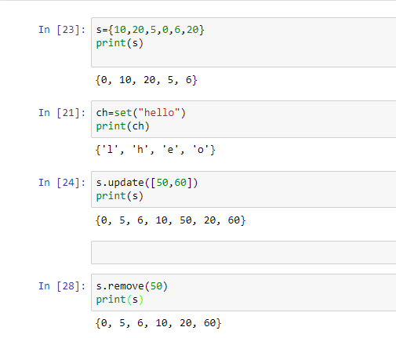
4) Set
1) set
Unordered elements
Does not accept duplicate elements
Elements are separated by commas and enclosed under curly braces

Slide 26
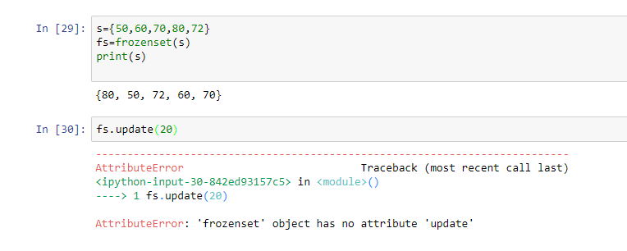
2) frozenset
Elements in the set can be modified.
But elements in frozenset cannot be modified.

Slide 27
5) Mapping
Map represents a group of elements in the form of key value pairs, so that when key is given, we can retrieve the value associated with it.
dict datatype is an example for a map.
Dict represents a directory that contains pairs of elements such that first element represents key and the next one becomes its value.
The key and value should be separated by a colon (:) and pair by comma.
All elements should be inside curly braces.

Slide 28
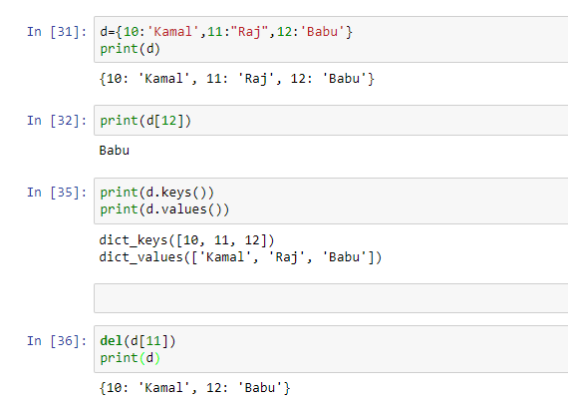

Slide 29
6) Boolean
The boolean data type is either True or False.
In Python, boolean variables are defined by the True and False keywords.
>>> a = True
>>> type(a)
<class 'bool'>
>>> b = False
>>> type(b)
<class 'bool'>

